Slide 1
Building the UArizona AZSecure Cybersecurity Program: Advancing Research and Education with “AI for Cybersecurity”
Dr. Hsinchun Chen
Director, AI Lab
Director, AZSecure Cybersecurity Program
Arizona Regents’ Professor, Thomas R Brown Chair Professor
Fellow, ACM, IEEE, AAAS, AIS
Acknowledgements: NSF DG, DIBB, CRI, SaTC, CICI, SFS

Slide 2
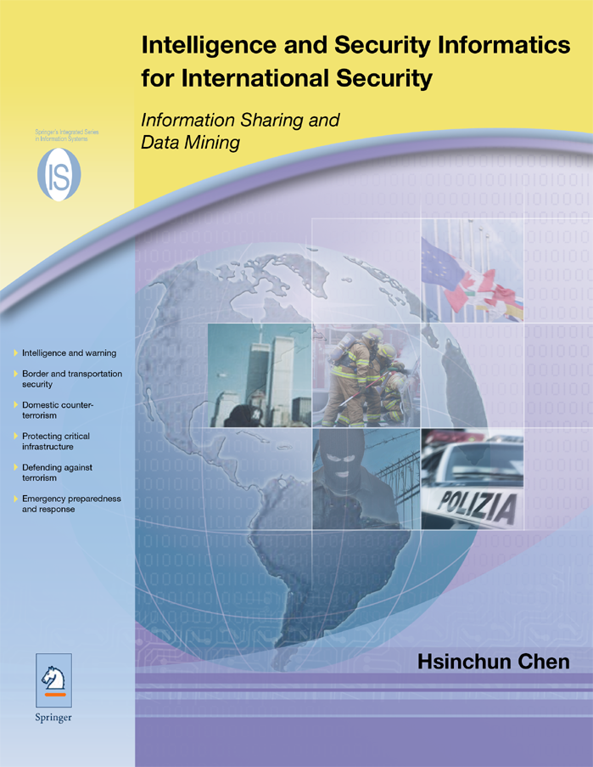
COPLINK, 1997-2007 (NSF DG)
Dark Web, 2002-2012 (NSF DIBB, CRI)
AI Lab Security Analytics Research in Three Decades:
AI, DM, ML, DL, Analytics
$60M funding
$500M tech transfer (IBM)

Slide 3
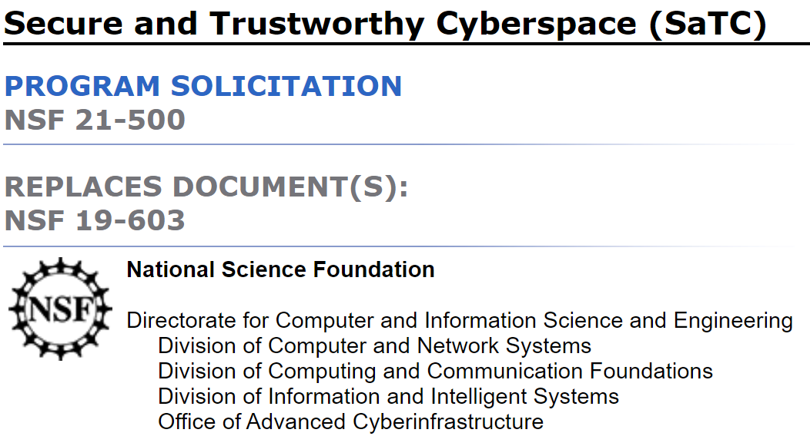
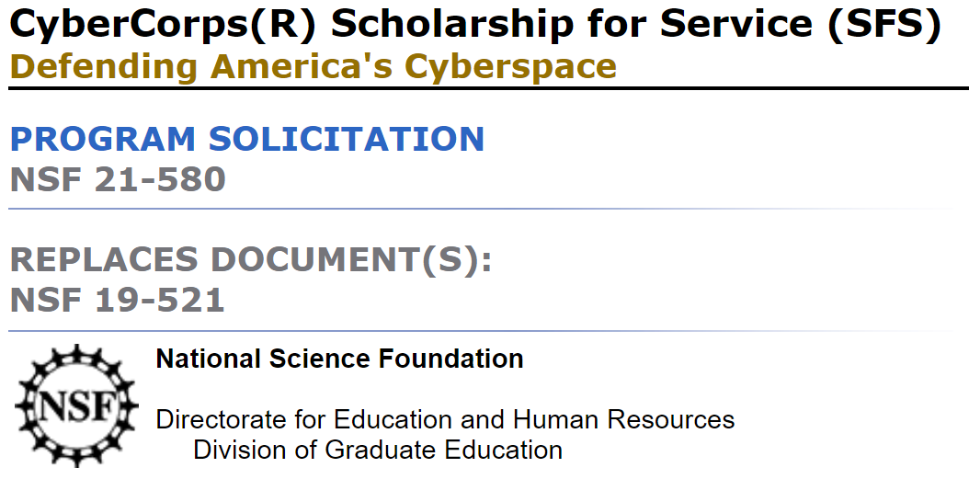
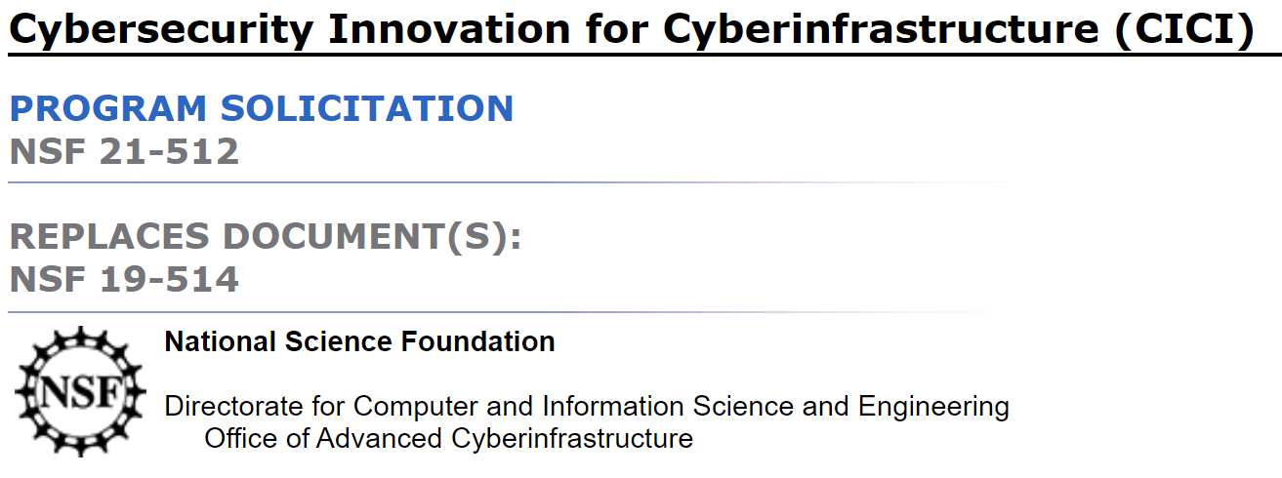
AZSecure Cybersecurity Analytics Program (2010-present): SaTC, SFS, CICI

Slide 4
AZSecure Cybersecurity Program: From Advanced Research to Education and Impact (Funding Acknowledgements)
Research: National Science Foundation, SaTC, CICI, $4M+, 2013-present
NSF, Secure and Trustworthy Cyberspace (SaTC) Program, “Securing Cyber Space: Understanding the Cyber Attacks and Attacks via Social Media Analytics,” $1.2M, SES-1314631, 2013-2018.
NSF, Cybersecurity Scholarship-for-Service at the University of Arizona Supplement, “Hacker Web Education Portal: Exploring the Hacker Community Assets,” $350K, DUE-1303362, 2014-2019.
NSF, CICI Program, “CICI: SSC: Proactive Cyber Threat Intelligence and Comprehensive Network Monitoring for Scientific Cyberinfrastructure: The AZSecure Framework,” $1M, 2019-2022.
NSF, SaTC Program, “SaTC: CORE: Small: Cybersecurity Big Data Research for Hacker Communities: A Topic and Language Modeling Approach,” $500K, 2019-2022.
➔ Publications, Ph.D./MS Students Training, Research Funding, AZSecure Curriculum (MIS 562, MIS 689)
Education: NSF, CyberCorps, PIF, SFS/SFI, $11M+, 2013-present
NSF, CyberCorps SFS Program, “Cybersecurity Scholarship-for-Service at the University of Arizona, $5.8M, DUE-1303362, 2013-2019.
NSF, CyberCorps SFS Program, “Cybersecurity Scholarship-for-Service Renewal at the University of Arizona: The AZSecure SFS Program,” $3.7M, 2019-2024.
Provost Investment Fund, University of Arizona, Digital Business in the 4IR: Cybersecurity Infrastructure, $1.7M, 2019-2022.
➔ Publications/Training, Government/Industry Placements, NSF/DHS CAEs, Real-World Impacts

Slide 5
“AZSecure SFS/SFI: Training the Next Generation of Cyber Warriors and Cybersecurity Professionals!”

Slide 6



AZSecure Cybersecurity Program: Two Tracks
Scholarship for Service (SFS)
Scholarship for Industry (SFI)
2013 – present: National Science Foundation
Awarded to-date: $9M
Total Number of Students: 46
$120K-$180K funding; MS Courses in Cyber+Analytics; Research Project/Mentorship
AI: ML, DL, Big Data + Cybersecurity: CTI, Cyber Capstone, National Cyber League NCL) competition
Graduates: 37 (35 MS & 1 PhD, Samtani)
97% Graduation Rate; 100% job placement
Current: 2 PhD (Ampel, Lazarine), 7 MS
2018 – present, Provost Investment Fund
Funded to-date: $1.7M
Total Number of Students: 14
$80K-$140K funding; MS Courses in Cyber+Analytics; Research Project/Mentorship
AI: ML, DL, Big Data + Cybersecurity: CTI, Cyber Capstone, National Cyber League NCL) competition
Graduates: 7 (MS)
87.5% Graduation Rate (one left due to COVID); 100% job placement
Current: 2 PhD (Ullman,
Nadubizu), 6 MS
Notes:
16

Slide 7
AZSecure Cybersecurity Program: Diversity
Gender
Ethnicity
Military
23% Female
42% non-White; 22% Hispanic
16% Veteran/Reserve/Active Duty
Notes:
11

Slide 8
AZSecure “AI + Cybersecurity” Student Projects: Dark Web Analytics, Smart Vulnerability Assessment, Privacy Analytics
Automatically Assigning Risk Levels to Exploits on the Dark Web: A Source Code Classification Approach
Automated Vulnerability Assessment of Blockchain-Based Smart Contracts
Explaining PII Attribute Inference Risk For Social Media Users: An Interpretive Model Agnostic Approach
Generating Security Nutrition Labels for Internet Of Things Device GitHub Repositories A Supervised Multi-Task Learning Approach
Identifying Exploit-Sharing Communities in Hacker Forums: A Generative Adversarial Approach
Mapping Malicious Source Code on Paste Sites to the MITRE ATT&CK Framework: A Multi-Label Transformer Approach
SFS
Linking Vulnerabilities in Cyberinfrastructure With Their Remediations: A Contrastive Representation Learning Approach
Identification of Open-Source Software Vulnerabilities in Industrial Internet of Things Devices
Machine Learning and Open-Source Tools in the Generation of Evasive Malware
Propagation of Misconfigurations Within Infrastructure-As-Code (IAC) Scripts
➔ AI + Cybersecurity (faculty mentorship in
AI, Analytics, CISE, SBE, MIS, EECS)
SFI

Slide 9
AZSecure Cybersecurity Student Publications: Major ACM/IEEE/IS Conferences, Journals, 60+ Papers (selected papers in 2020)
B. Ampel, S. Samtani, S. Ullman and H. Chen, “Linking Common Vulnerabilities and Exposures to the MITRE ATT&CK Framework: A Self-Distillation Approach,” 1st Workshop on Artificial Intelligence-enabled Cybersecurity Analytics at ACM Knowledge Discovery and Data Mining (KDD), August 14-18, 2021.
M. Ebrahimi, N. Zhang, J. Hu, M. Taqi Raza, H. Anderson, and H. Chen, “Binary Black-box Evasion Attacks Against Deep Learning-based Static Malware Detectors with Adversarial Byte-Level Language Model," 35th AAAI Conference on Artificial Intelligence, Workshop on Robust, Secure, and Efficient Machine Learning (RSEML), February 2-9, 2021.
Y. Liu, F. Lin, Z. Ahmad-Post, M. Ebrahimi, N. Zhang, J. Hu, J. Xu, W. Li, and H. Chen, “Identifying, Collecting, and Monitoring Personally Identifiable Information: From the Dark Web to the Surface Web,” in 2020 IEEE International Conference on Intelligence and Security Informatics (ISI), November 9-10, 2020.
B. Lazarine, S. Samtani, M. Patton, H. Zhu, S. Ullman, B. Ampel, and H. Chen, “Identifying Vulnerable GitHub Repositories and Users in Scientific Cyberinfrastructure: An Unsupervised Graph Embedding Approach,” in 2020 IEEE International Conference on Intelligence and Security Informatics (ISI), November 9-10, 2020.
S. Ullman, S. Samtani, B. Lazarine, H. Zhu, B. Ampel, M. Patton, and H. Chen, “Smart Vulnerability Assessment for Scientific Cyberinfrastructure: An Unsupervised Graph Embedding Approach,” in 2020 IEEE International Conference on Intelligence and Security Informatics (ISI), November 9-10, 2020.
B. Ampel, S. Samtani, H. Zhu, S. Ullman, and H. Chen, “Labeling Hacker Exploits for Proactive Cyber Threat Intelligence: A Deep Transfer Learning Approach,” in 2020 IEEE International Conference on Intelligence and Security Informatics (ISI), November 9-10, 2020. Best Paper Award.
N. Zhang, M. Ebrahimi, W. Li, and H. Chen, “A Generative Adversarial Learning Framework for Breaking Text-Based CAPTCHA in the Dark Web,” in 2020 IEEE International Conference on Intelligence and Security Informatics (ISI), November 9-10, 2020.
F. Lin, Y. Liu, M. Ebrahimi, Z. Ahmad-Post, J. Hu, J. Xin, S. Samtani, W. Li, and H. Chen, “Linking Personally Identifiable Information from the Dark Web to the Surface Web: A Deep Entity Resolution Approach,” in 2020 IEEE 20th International Conference on Data Mining Workshops, November 17-20, 2020.
M. Ebrahimi, S. Samtani, Y. Chai, and H. Chen, “Detecting Cyber Threats in Non-English Hacker Forums: An Adversarial Cross-Lingual Knowledge Transfer Approach,” IEEE Symposium on Security and Privacy (IEEE S&P 2020) Workshop on Deep Learning for Security (DLS), San Francisco, CA, May 21, 2020.

Slide 10


AZSecure Cybersecurity Program: MS Placement & Success
SFS
SFI
36 Graduates - 100% Job Placement
7 Graduates - 100% Job Placement
Sample Agencies:
Department of Defense (10)
FFRDC/MITRE (6)
National Labs (4)
DHS/FBI/NSA (6)
State University (1)
Department of Commerce (1)
Sample Companies:
Deloitte
KPMG
MITRE
Raytheon
Amazon
UArizona AZSecure teams placed #4 in 2021 and #5 in 2022, The National Cyber League (NCL) Competition

Slide 11

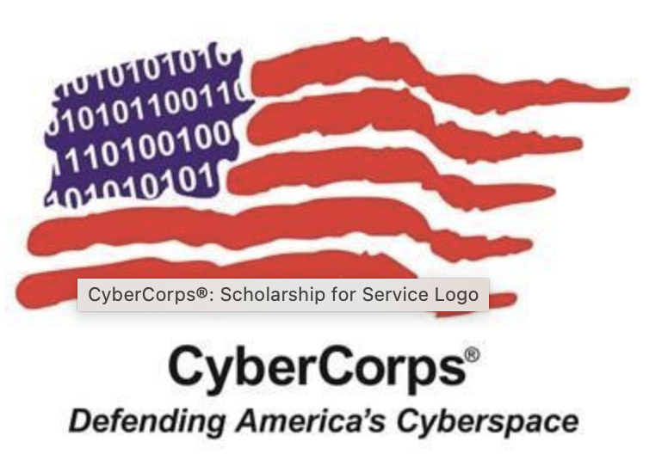
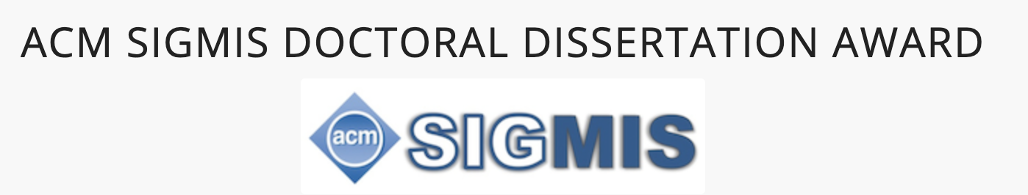
AZSecure Cybersecurity Program: Ph.D. Placement & Success
ACM SIGMIS Doctoral Dissertation Awards:
2021, Reza Ebrahimi, University of South Florida, “AI Enabled Cybersecurity Analytics: Detecting and Defending against Cyber Threats” (NSF SaTC)
2019, Sagar Samtani, Indiana University, “Developing Proactive Cyber Threat Intelligence from the Online Hacker Community: A Computational Design Science Approach” (NSF SFS, CICI)
CyberCorps SFS Hall of Fame:
2022, Sagar Samtani, Indiana University
The Hall of Fame recognizes one SFS alum for their outstanding contributions to the cybersecurity community, achievements post-graduation, and overall excellence as a scholarship recipient.
One recipient out of 5,000+ SFS alums each year

Slide 12
UArizona AZSecure Cybersecurity Program: Advancing Research and Education Questions?
Dr. Hsinchun Chen
hchen@eller.Arizona.edu
Director, AI Lab
Director, AZSecure Cybersecurity Program
Arizona Regents’ Professor, Thomas R Brown Chair Professor
MIS Department

